Slide 1
Project Quality Management

Slide 2
Quality
“an inherent or distinguishing characteristic; a property; having a high degree of excellence”
  “fitness for use”
  “conformance to requirements or a predefined set of standards”
Important not to define quality only in terms of features & functionality (eg in the case of luxury vs economy car – dependability? Safety? )

Slide 3
63,000 known bugs in Windows 2000?
In February 2000, a Microsoft Corp memo caused quite a stir when it was leaked to the public. An excerpt from that memo reads
“Our customers do not want us to sell them products with over
63,000 potential defects. They want those defects corrected.
How many of you would spend $500 on a piece of software with
over 63,000 potential known defects?”

Slide 4
Project Quality Management (PQM) - PMBOK®
The processes required to ensure that the project will satisfy the needs for which it was undertaken. It includes all activities of the overall management function that determine the quality policy, objectives, and responsibility and implements them by means of quality planning, quality assurance, quality control, and quality improvement within the quality system (95).

Slide 5
PMBOK® – Project Quality Management Process
Quality Planning
  Determining which quality standards are important and how they will be met.
Quality Assurance
  Evaluating overall project performance to ensure quality standards are being met.
Quality Control
  Monitoring the activities and results of the project to ensure that the project complies with the quality standards.

Slide 6
PQM Focuses on:
The project’s products
  The IT Solution
  Business Case
  Project Plan
  Etc.
And the project’s processes
  Scope management
  Risk management
  Requirements Analysis
  Design
  Implementation
  Etc.

Slide 7


The Quality Chain
More efficient & effective use of resources
Minimize errors
Meet or exceed stakeholder expectations
More rework, waste, & errors
Negative impact on project goal & objectives
Poor quality can be an embarrassment!

Slide 8
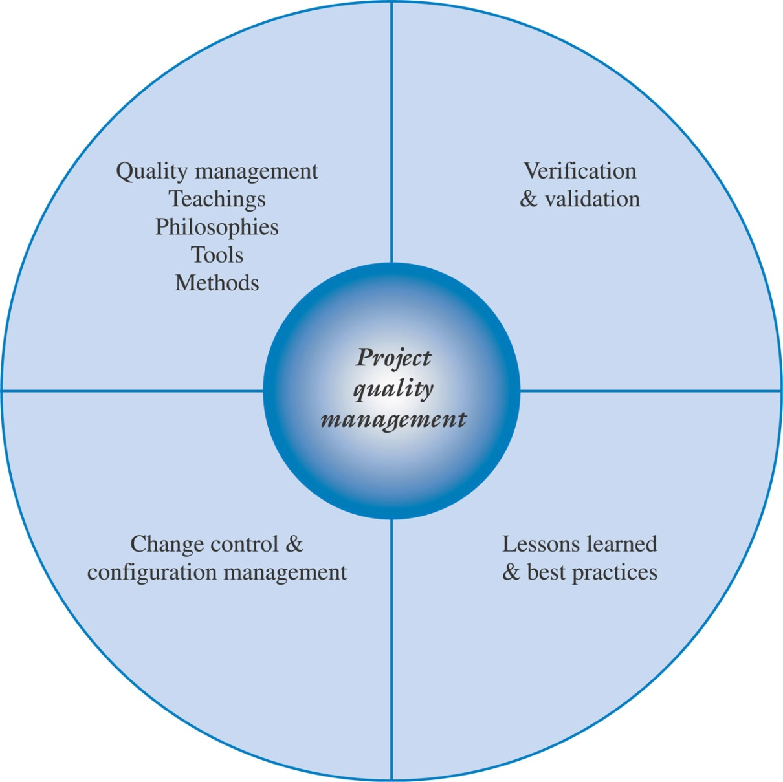
Project Quality Management

Slide 9
Project Quality Management
Verification and validation should be carried out throughout the project life cycle.
Questions to ask:
  Are we building the right product?
  Are we building the product the right way?
    Project quality plan should focus not only on testing the final delivarable – an error is less costly to fix earlier than later in the project’s life cycle
Knowledge management and lessons learned lead to continuous improvement and maturing of IT project management processes

Slide 10
Quality Systems
A number of organisations and approaches for defining and implementing quality standards in organisations exist
  “Standards are documented agreements, protocols or rules that outline the technical specifications or criteria to be used to ensure that products, services, processes and materials meet their intended purpose”
  “Also provide a basis for measurement because they provide criterion or basis for comparison”
  (Marchewka, 2006)

Slide 11
Quality Systems
International Organization for Standardization (ISO)
  One of most widely known standards organization
  Derived from Greek word “isos,” meaning equal
  Formed in 1947 by delegates from 25 countries
  Today has over 130 members “to facilitate the international coordination and unification of industrial standards.”
  A set of standards make up the ISO 9000 (organizations) and ISO 14000 (environmental) families

Slide 12
Quality Systems
International Organization for Standardization (ISO)
  ISO 9000 – Focus:
    Improved customer satisfaction
    Continuous improvement of organisation’s performance and processes
  ISO 14000 - Focus:
    Environmental management – minimising harmful effects by activities and operations

Slide 13
Quality Systems
ISO 9000 Principles
Customer Focus
Leadership
Involvement of People
Process Approach
System Approach to Management
Continual Improvement
Factual Approach to Decision Making
Mutually Beneficial Supplier Relationships

Slide 14
Quality Systems
The Capability Maturity Model Integration (CMMI)
Software Engineering Institute (SEI) at Carnegie-Mellon University
Includes a set of recommended practices for a set of key process areas specific to software development.
Provide guidance as to how an organization can best control its processes for developing and maintaining software.
Provide a path for helping organizations evolve their current software processes toward software engineering and management excellence

Slide 15
CMMI – some definition of terms
Software Process
  The logical organization of people, materials, energy, equipment, and procedures into work activities to produce a specified end result
Software Process Capability
  The expected results that can be achieved by following a particular software process that can be used to predict the outcome if a software process is followed
Software Process Performance
  The actual results achieved when a particular software process is followed so that actual performance can be compared to expected results
Software Process Maturity
  The extent to which a particular software process is explicitly and consistently defined, managed, measured, controlled, and effectively used

Slide 16
Quality Systems
CMMI
Immature Software Organization
  Software processes are improvised or developed ad hoc
  Reactive in nature - Managers continually “fight fires”
  Schedules & budgets are usually exceeded
  Functionality & quality often compromised to meet schedules
  Project success determined by who is or is not part of the project team
  No basis for judging quality
  Never seems to be enough time to address problem issues or improve the current processes

Slide 17
Quality Systems
CMMI
Mature Software Organization
  Proactive and able to follow a set of disciplined processes throughout the software project.
  Software processes and the roles of individuals are defined explicitly and communicated throughout the organization.
  Software processes are consistent throughout the organization and continually improved based on experimentation or experiences.
  Quality of each software process is monitored so that the products and processes are predictable across different projects.
  Budgets and schedules are based on past projects so they are more realistic and the project goals and objectives are more likely to be achieved.

Slide 18
Maturity Levels
Maturity levels lay successive foundations for continuous improvement
Can measure the maturity of an organization’s software process
Can evaluate its software process capability
Help prioritize improvement efforts

Slide 19
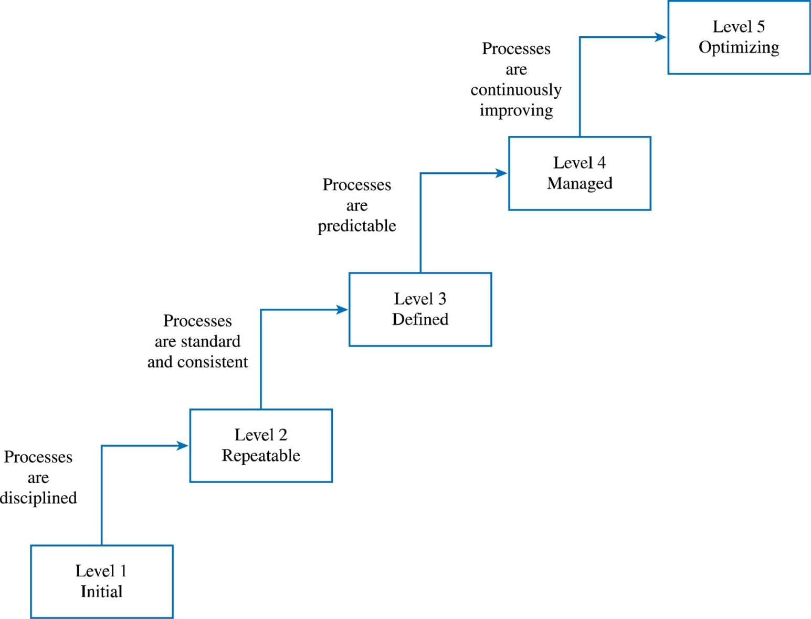
CMMI Levels of Software Process Maturity

Slide 20
CMMI Levels of Software Process Maturity
Level 1: Initial
  Characterized by an immature software organization in which the software process is ad hoc and often reactive to crises. Does not have a stable environment for software projects, and success of a project rests largely with the people on the project and not the processes that they follow.
  Key Process Area
    no key process areas are in place

Slide 21
CMMI Levels of Software Process Maturity
Level 2:
  Repeatable - Basic policies, processes, and controls for managing a software project are in place.
  Previous project successes can be repeated by other project teams on other projects.
  Key Process Area
    Software Configuration Management
    Software Quality Assurance
    Software Subcontract Management
    Software Project Tracking and Oversight
    Software Project Planning
    Requirements Management

Slide 22
CMMI Levels of Software Process Maturity
Level 3:
  Defined - Software engineering and management processes are documented and standardized throughout the organization and become the organizations standard process.
  Key Process Area
    Peer Reviews
    Intergroup Coordination
    Software Product Engineering
    Integrated Software Management
    Training Programs
    Organization Process Definition
    Organization Process Focus

Slide 23
CMMI Levels of Software Process Maturity
Level 4:
  Managed - Quantitative metrics for measuring and assessing productivity and quality are established for both software products and processes which are characterized as being quantifiable and predictable.
  Key Process Areas
    Software Quality Management
    Quantitative Process Management

Slide 24
CMMI Levels of Software Process Maturity
Level 5:
  Optimizing - at the highest level of software process maturity- the whole organization is focused on continuous process improvement.
  Key Process Areas
    Process Change Management
    Technology Change Management
    Defect Prevention

Slide 25
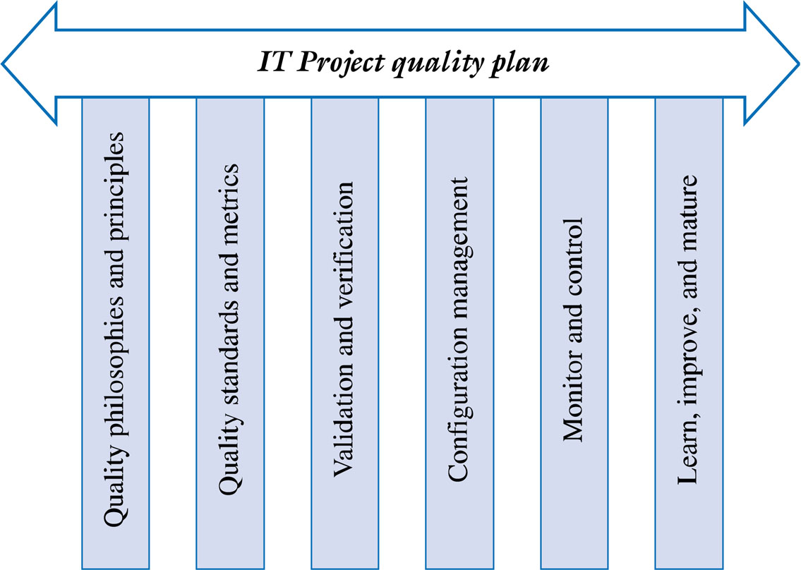
The IT Project Quality Plan

Slide 26
The IT Project Quality Plan
Quality Philosophies and Principles
Defines the direction and overall purpose of the plan.
Common themes:
  Focus on customer satisfaction
  Prevention, not inspection
  Improve the process to improve the product
  Quality is everyone’s responsibility
  Fact-based management

Slide 27
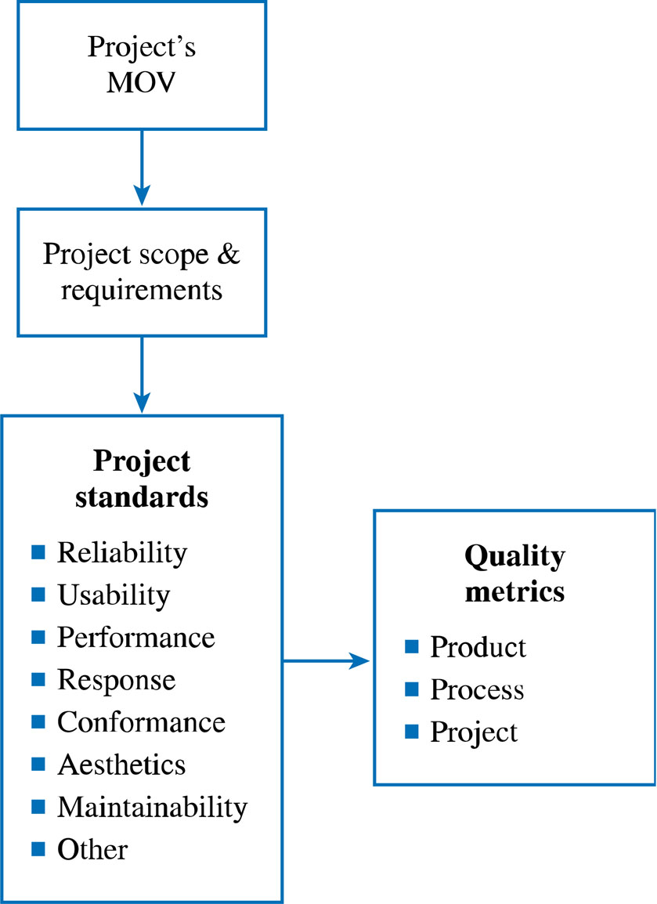
The IT Project Quality Plan
Quality Standards and Metrics

Slide 28
Project Quality Metrics
Process
  Control the defects introduced by the processes required to create the project deliverables
  Can be used to improve software development or maintenance
  Should focus on the effectiveness of identifying and removing defects or bugs

Slide 29
Project Quality Metrics
Product
  Focuses on the intrinsic quality of the deliverables and satisfaction of the customer, client, or sponsor with these deliverables
  Attempt to describe the characteristics of the project’s deliverables and final product

Slide 30
Project Quality Metrics
Project
  Focus on the control of the project management processes to ensure that the project meets its overall goal as well as its scope, schedule, and budget objectives

Slide 31
Examples of Process, Product, & Project Metrics
Type | Metric | Description
Process | Defect Arrival Rate | The number of defects found over a specific period of time.
 | Defects by Phase | The number of defects found during each phase of the project.
 | Defect Backlog | The number of defects waiting to be fixed.
 | Fix Response Time | The average time it takes to fix a defect.
 | Defective Fixes | The number of fixes that created new defects.
Product | Mean Time to Failure | Average or mean time elapsed until a product fails.
 | Defect Density | The number of defects per lines of code (LOC) or function points.
 | Customer Found Defects | The number of defects found by the customer.
 | Customer Satisfaction | An index to measure customer satisfaction – e.g., scale from 1 (very unsatisfied) to 5 (very satisfied)
Project | Scope Change Requests | The number of scope changes requested by the client or sponsor.
 | Scope Change Approvals | The number of scope changes that were approved.
 | Overdue tasks | The number of tasks that were started but not finished by the expected date or time.
 | Tasks that should have started | The number of task that should have started but have been delayed.
 | Over budgeted tasks | The number of tasks (and dollar amount) of tasks that have cost more to complete than expected
 | Earned Value | Budgeted Cost of Work Performed (BCWP) – see Chapter 8.
 | Over allocated Resources | The number of resources assigned to more than one task.
 | Turnover | The number of project team members who quit or terminated.
 | Training Hours | The number of training hours per project team member.

Slide 32
The IT Project Quality Plan
Verification and Validation
Verification
  Focuses on process-related activities to ensure that the products & deliverables meet specified requirements before final testing
  Are we building the product the right way?

Slide 33
Verification
Technical Reviews
  Ensure that the IT solution will conform to the specified requirements
      Walk-through’s are review process where a programmer or developer “walks” or leads a group of other programmers or developers through a program or technical design
Business Reviews
  Are designed to ensure that the IT solution provides the required functionality defined in the project scope and detailed requirements definition to ensure that a particular project deliverable
    Is complete
    Provides information necessary for the next phase or process
    Meets predefined standards
    Conforms to the project (and software development) methodology
Management Reviews
  Compares the project’s actual progress against the baseline project plan
  Useful for resolving issues or making critical decisions
  Usually focuses on the project’s scope, schedule, budget, and quality objectives

Slide 34
The IT Project Quality Plan
Verification and Validation
Validation focuses on
  Product-oriented activities that attempt to determine if the system or project deliverables meet the customer or client’s expectations
  Testing
    Does the system function as intended and have all the capabilities & features defined in the project’s scope and requirements definition?

Slide 35
Software Testing Approaches
Unit Testing | Focuses on the module, program, or object level to determine whether specific functions work properly. Black Box Testing – Tests the program against specified requirements or functionality. White Box Testing – Examines paths of logic or the structure inside a program. Gray Box Testing – Focuses on the internal structure of the program.
Integration Testing | Tests whether a set of logically related units (e.g., functions, modules, programs, etc.) work together properly after unit testing is complete.
Systems Testing | Tests the system as a whole in an operating environment to verify functionality and fitness for use. May include tests to verify usability, performance, stress, compatibility, and documentation.
Acceptance Testing | Certifies that the system satisfies the end user or customer’s scope and detailed requirements after systems testing is complete. It is the user’s or client’s responsibility to assure that all features and functionality are included so that the project’s MOV will be achieved.

Slide 36
The IT Project Quality Plan
Change Control and Configuration Management
Change is inevitable throughout the project life cycle
At some point, changes must be managed
  What changes were made?
  Who made the changes?
  When were the changes made?
  Why were the changes made?
Configuration management includes a set of processes and tools that allow the project team to manage its various documents and files with changing configurations

Slide 37
The IT Project Quality Plan
Configuration Management elements
Component Identification
  Naming conventions
Version Control
  Documentation of evolutionary changes
Configuration Building
  Builds & Release procedures
Change Control
  Proposed changes are evaluated, approved or rejected, scheduled, and tracked
  Reporting & auditing

Slide 38
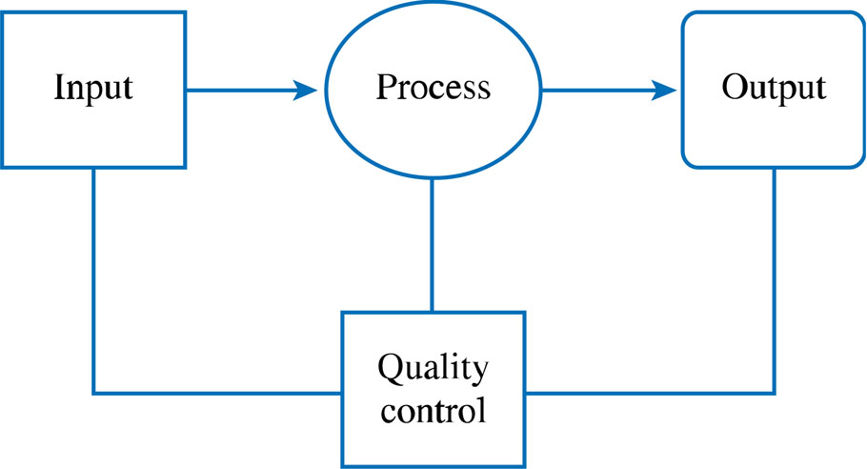
Monitor and Control
Quality Control Activities
Quality Control Activities should focus on the inputs
and outputs of each process. This can be viewed
in terms of the systems concept.

Slide 39
Learn, Mature, and Improve
Lessons learned
  Provide the basis for continual improvement
  Can be the basis for identifying and implementing best practices
A quality plan should do more that attempt to build a better IT solution. It should also support the organization in searching for ways to manage projects better.

